Slide 1
When and why does ApET work?
CSE590 · MIDTERM PROGRESS
Understanding reconstruction-based visual token compression in LLaVA-1.5-7B
THE COST
APET’S IDEA
OUR QUESTION
Each image becomes 576 visual tokens, which dominate inference cost.
Keep tokens that are hard to reconstruct linearly; merge the easy ones away.
Does “hard to reconstruct” match what the model needs to answer?
Peng Chen · SBU ID 117702477 · October 2026
Notes:
This project studies ApET, a training-free method that compresses the visual tokens of a vision-language model. LLaVA-1.5 turns every image into 576 tokens, and ApET keeps only the ones that are hard to reconstruct from a small basis, merging the rest into similar kept tokens. Our question is whether this geometric criterion really matches what the language model needs to answer a question — and where ApET’s success actually comes from.

Slide 2



Three research questions; first-half goals met
RQ1
Diagnostics largely complete
FIRST-HALF OBJECTIVES · ALL MET
How does reconstruction-based redundancy relate to a token’s contribution to the answer, across tasks and layers?
Run native ApET and uncompressed LLaVA-1.5 in a reproducible environment
Prepare GQA, MMStar and TextVQA subsets, baselines and scoring
RQ2
Comparisons done; attribution open
How much of ApET’s effectiveness comes from error-based selection, and how much from merging?
Instrument errors, selections, merges and answer responses
RQ3
Exploratory; none chosen
Can the analysis support a lightweight improvement, such as an adaptive budget?
From the project proposal; status as of the midterm. · 2 / 9
Notes:
The proposal asked three questions. RQ1: how does ApET’s notion of redundancy relate to what a token contributes to the answer? RQ2: how much of ApET’s success comes from its error-based selection, and how much from merging? RQ3: can this analysis support a small improvement? For the first half, I committed to three things: a reproducible environment running native ApET, prepared datasets with baselines and scoring, and instrumentation of errors, selections, merges and answer responses. All three are done. RQ1’s planned diagnostics are largely complete, RQ2’s main comparisons are done but we cannot yet say which component is responsible, and RQ3 is still exploratory.

Slide 3

ApET keeps hard-to-reconstruct tokens and merges the rest
Image
CLIP encoder
ApET stage 1
LLM
ApET stage 2
LLM
336×336
576 tokens
keep K₁
blocks 1–16
keep K₂
blocks 17–32
INSIDE EACH APET STAGE
1 · Pick a basis
2 · Score and keep
3 · Merge the rest
10 tokens chosen by farthest-point sampling in feature space.
Error E = how poorly a token is rebuilt from the basis. Keep the highest E.
Average each dropped token into its most similar kept token.
RQ1 · Does E rank tokens by their effect on the answer?
RQ2 · Complete ApET vs. random pruning
Same budgets (avg. 64 or 192 tokens); GQA 800, MMStar 1,500, TextVQA 100; 3 seeds.
30-question diagnostic set; set one token to zero, or keep only one token.
LLaVA-1.5-7B · FP16 on Kaggle 2×T4 · locked environment (PyTorch 2.1.2, Transformers 4.37.2) · 3 / 9
Notes:
Here is the pipeline. The image goes through the CLIP encoder and becomes 576 tokens. ApET compresses twice: once before the language model, and again after block 16 of 32. Inside each stage it does three things: pick 10 basis tokens, keep the tokens with the highest reconstruction error, and merge each dropped token into its most similar kept token. We ask two questions. RQ1: does the error E actually rank tokens by how much they matter for the answer? We test this on 30 questions by zeroing one token, or keeping only one token. RQ2: how does complete ApET compare with simple random pruning at the same token budget? We added this comparison because early small tests suggested random could keep some answers ApET lost, and the ApET paper only randomizes the basis, not which tokens are kept.

Slide 4
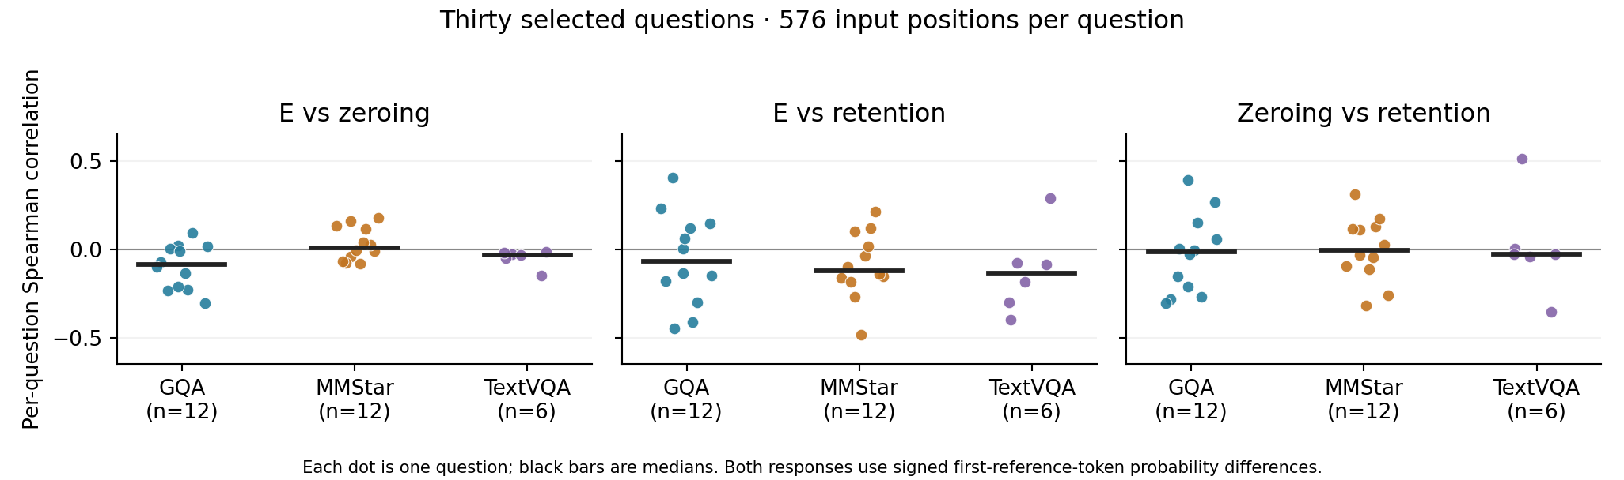
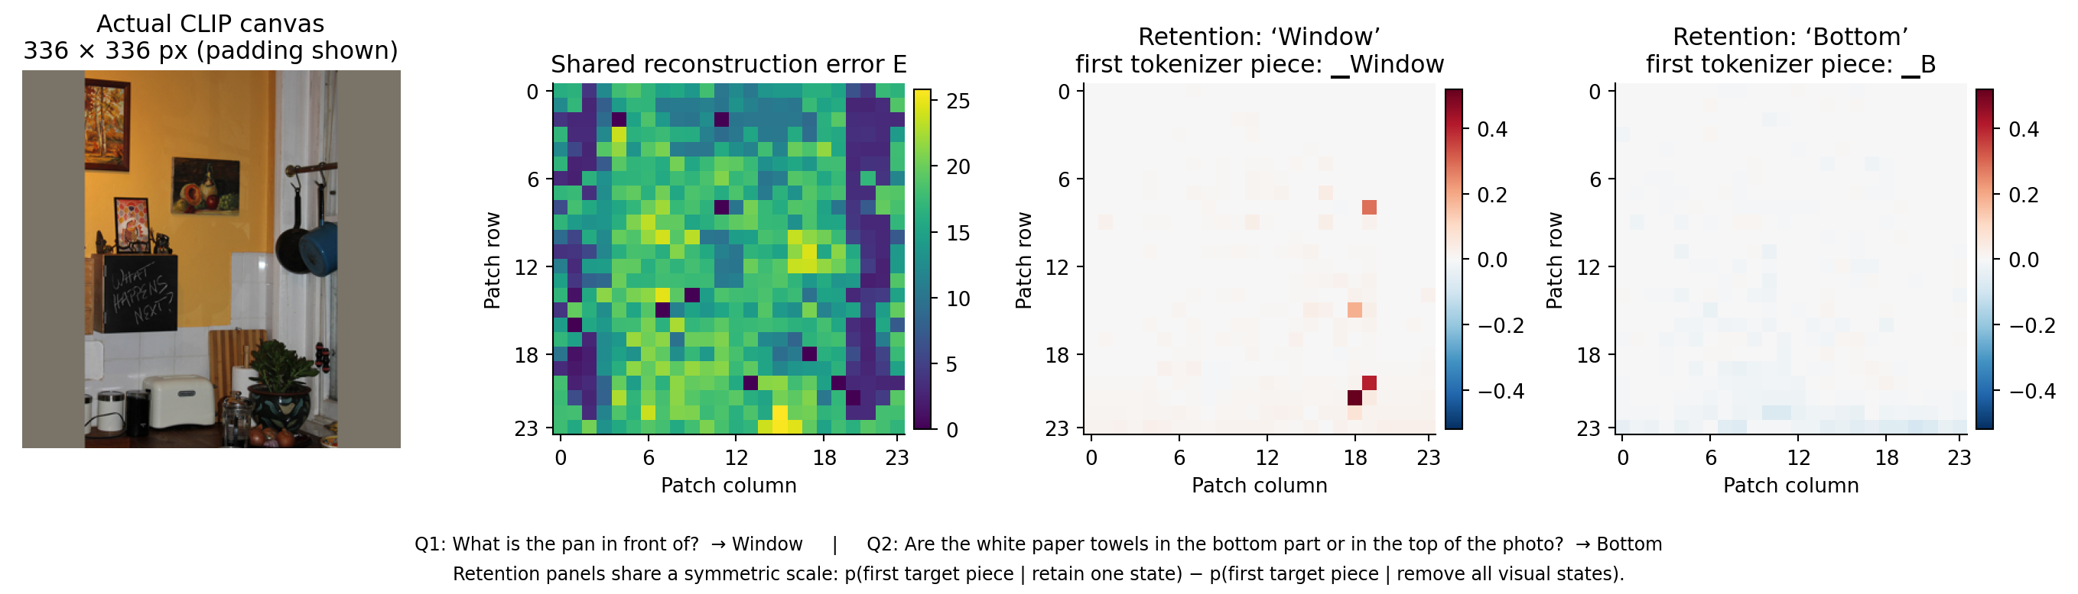
Finding 1: error E does not consistently rank tokens by their effect on the answer
−0.14 to +0.01
median correlation of E with answer effect, in every dataset (30 questions)
Single questions range from −0.49 to +0.40: not zero, but inconsistent.
The two answer measures barely agree with each other either.
Bottom: one image, one E map, but each question depends on different tokens.
Answer effect = change in the first answer token’s probability when one token is zeroed, or kept alone. · 4 / 9
Notes:
RQ1 asks whether ApET’s reconstruction error ranks tokens by how much they matter for the answer. For each of the 576 tokens we measured its effect two ways: set it to zero, or keep only that token, and watch the probability of the answer. The top plot shows one dot per question. The median correlations with E are close to zero in every dataset, between minus 0.14 and plus 0.01. Individual questions range from about minus 0.5 to plus 0.4, so E is not useless, but its relationship to the answer is inconsistent. Even our two measures disagree with each other. The bottom figure makes this concrete: two questions about the same image share exactly the same E map, because E is computed before the question is seen, yet the tokens that matter differ by question. This is a 30-question diagnostic set, so these are descriptive results.

Slide 5
ApET’s advantage over random pruning is task-dependent
Accuracy (%) at an average budget of 64 visual tokens (schedule 96→32)
Uncompressed (576)
ApET
Random pruning (3-seed mean)
ApET − random
TextVQA
49.7
+20.9 pts
100 questions
41.5
20.6
95% CI [13.9, 29.0] · lost 10 vs. 28.7
GQA
69.0
+2.5 pts
800 questions
63.8
61.3
95% CI [0.3, 4.7] · lost 78 vs. 97.3
MMStar
34.7
−0.1 pts
1,500 questions
33.4
33.5
95% CI [−1.4, 1.1] · not detectable
The puzzle: on its own, E does not consistently rank tokens by their effect on the answer (RQ1). So which part of ApET — selection, basis or merging — produces the gain?
“Lost” = answers correct without compression that became wrong. Same pattern, smaller, at 192 tokens. · 5 / 9
Notes:
This is the key result. At an average budget of 64 tokens, ApET beats random pruning by about 21 points on TextVQA, by 2.5 points on GQA, and there is no detectable difference on MMStar, where the model itself is close to chance. The advantage comes mainly from losing fewer answers that were already correct: on TextVQA, ApET loses 10 of 44 correct answers, random loses about 29. But RQ1 showed that reconstruction error does not consistently rank individual tokens by their effect on the answer — the median correlations are about zero. So ApET works better than random, but we don’t yet know which part of it — the error-based selection, the basis, or the merging — is responsible. Note: the small 30-question set first suggested random might be as good, but that set was chosen from ApET’s own failures; the large comparison corrects that impression.

Slide 6
Why does ApET beat random? Two open hypotheses
HOW WE GOT HERE
Small component tests: random retention kept some answers ApET lost.
ApET’s paper randomizes only the basis, never which tokens are kept.
So we compared at scale: ApET wins on average (Finding 2).
H1 · Selection
H2 · Representation preservation
E-based selection keeps more useful tokens than random, e.g., by dropping easy padding or background, even if it ranks single tokens poorly.
Keeping basis representations and merging dropped tokens into kept ones preserves information that random pruning loses.
Possible test: merging on vs. off under the same selection.
Possible test: vary only selection; keep basis and merging fixed.
Both may hold. The 30-question set cannot separate them: it was picked from ApET’s own outcomes, so its 11 ApET losses are failures by construction.
Random pruning differs from ApET in selection, basis handling and merging at once. · 6 / 9
Notes:
Why did we test random pruning at all? It was not in the proposal. During the RQ2 component tests, random retention sometimes kept answers that ApET lost, for example on text questions. The ApET paper only compares different ways of choosing the basis; it never compares against randomly choosing which tokens to keep. So we ran that comparison at scale, and ApET won on average. But random pruning differs from ApET in three things at once: selection, the basis, and merging. So there are two open explanations. H1: the error-based selection itself is useful, perhaps because it throws away padding and plain background, even though it ranks single tokens poorly. H2: keeping the basis and merging dropped tokens preserves information. Both could be true. Our small 30-question set cannot tell them apart, because it was chosen from ApET’s own failures, which builds in an advantage for any other method.

Slide 7
RQ3 check, interpretation and validity
RQ3 FEASIBILITY CHECK
Worked
Did not work
AUROC 0.41–0.57
ApET clearly beats random on TextVQA, mainly via fewer losses; GQA retention close to the paper’s.
E does not consistently rank tokens by answer effect; image-level E did not predict failures.
Three image-level E features gave weak prediction of ApET losses; no clear gain over the base rate.
56 of 100 GQA images had both lost and kept questions under the same input.
Surprising failure
Not yet met
Merging changed “Brolio” to “Bottoli”; undoing one kept token’s merge restored it.
Which component drives the gain (RQ2), and a supported RQ3 direction.
Not adopted; question-aware policies remain open.
Validity checks: no-compression and fixed-feature replays matched reference outputs exactly; all 90 recomputed correlations matched; loss/gain counts consistent in all 27 conditions.
Feasibility check: five image-grouped folds on saved E values, no new GPU runs. · 7 / 9
Notes:
For RQ3 we did a quick feasibility check using saved data only: can simple image-level statistics of E predict which images ApET will fail on? That would be needed for an adaptive token budget. The answer was no: out-of-fold AUROC was 0.41 to 0.57, close to chance, and no better than predicting the base rate. A telling detail: on GQA, 56 of 100 images had some questions ApET lost and others it kept, with exactly the same compressed input, so failures depend on the question, not just the image. On the right is the summary. What worked: ApET clearly beats random on TextVQA. What did not: E does not rank tokens by their answer effect, and the image-level predictor failed. A surprising failure: merging turned the wine brand Brolio into Bottoli, and undoing the merge for a single kept token fixed it. Still open: which component drives the gain, and whether any improvement is justified. Our validity checks all passed.

Slide 8
Roadblocks and fixes
Independent issues, each with its own fix and status
Roadblock | What happened | Fix / action | Status
Integration | Kaggle package updates broke ApET/LLaVA compatibility. | Locked environment with recorded fixes. | Green: resolved
Run-to-run variation | Fresh compressed runs changed a few answers; replays from saved features were identical. | Diagnostic traced it to the merge step (likely order-dependent FP16 sums); keep first runs, repeat critical cases. | Yellow: managed, cause not isolated
Selection bias | The 30-question set was picked from ApET’s own outcomes, so it favors other methods. | Use it only for RQ1 and case studies; compare components on unselected subsets. | Yellow: handled by design
Planning risk | Component attribution may stay unclear; no RQ3 candidate yet. | Report a well-controlled negative result. | Yellow: open
Merging uses CUDA scatter_add_; GPU additions can run in a different order each time, and FP16 addition is not exactly associative. · 8 / 9
Notes:
These are separate problems, each with its own fix. First, integration: package updates on Kaggle broke compatibility; we locked the environment, and this is resolved. Second, run-to-run variation: re-running the same compressed setting from scratch changed a few answers, while replays from saved features did not. A targeted diagnostic showed everything was identical until the merge step, so the likely cause is that the GPU adds merged tokens in a different order each run, which slightly changes 16-bit results. We keep the first runs as official results and repeat any case a conclusion depends on. Third, selection bias: our small diagnostic set was chosen from ApET’s own outcomes, which favors other methods, so we use it only for RQ1 and case studies. Finally, a planning risk: we may not fully pin down which component matters, and if so we will report a careful negative result.

Slide 9
Next: does “easy to reconstruct” mean the model can still use it?
(a) Test ApET’s assumption
(b) Look inside merging
For low-E tokens, compare answers when a token is kept, merged, dropped, or replaced by its linear reconstruction.
Measure how averaged tokens differ from the originals; vary the merge rule with the kept tokens fixed.
Date | Milestone
Oct 30 | Submit report and slides
Nov 6 | Choose one comparison; write its protocol
Nov 13 | Pilot on a small unselected subset
Nov 20 | Main run at 96→32 (288→96 if feasible)
Nov 24 | RQ3 go/no-go
Dec 15 | Final presentation, report and code
SUCCESS CRITERION
One controlled comparison isolating a single ApET component on ≥100 unselected questions: matched budgets, 3 seeds, paired 95% intervals. Negative results count.
Stretch: an RQ3 modification, only if the analysis supports it.
Deprioritized: better basis selection (ApET’s own ablation shows FPS ≈ random basis). · 9 / 9
Notes:
For the second half, the likely focus is one question: when ApET calls a token “easy to reconstruct” and merges it away, can the language model still use that information? The model never actually rebuilds the token — it only receives a merged average. So, first, we test ApET’s assumption directly: for low-error tokens, compare the answer when the token is kept, merged, dropped, or replaced by its linear reconstruction. Second, we look inside merging: how different are the averaged tokens from the originals, and does the merge rule matter when the kept tokens are fixed? The direction is still being finalized. The timeline: choose the comparison by November 6, a pilot by the 13th, the main run by the 20th, and an RQ3 go/no-go by the 24th. The success criterion is modest and measurable: one controlled comparison on at least 100 unselected questions, with matched budgets, three seeds and paired intervals; a clear negative result counts. We are not spending time on better basis selection, because ApET’s own ablation shows random and FPS bases perform about the same.

